Slide 1

Chapter 3.3
Poisson Processes
Performance Evaluation of the Internet of Things (IoT)
Module Course: Performance Evaluation of Distributed Systems
Prof. Tobias Hoßfeld, Summer Semester 2022

Slide 2
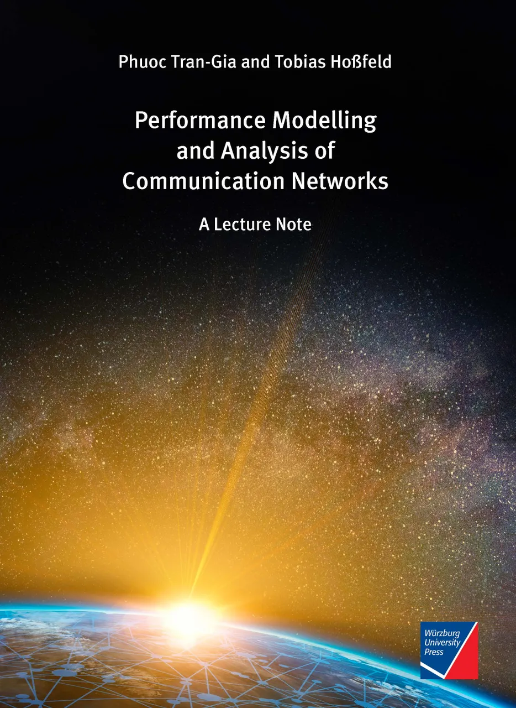
Disclaimer and Copyright Notice
Lecture slides, figures, and scripts are based on the open access text book “Performance Modeling and Analysis of Communication Networks”. The book and scripts are licensed under the Creative Commons License Attribution-ShareAlike 4.0 International (CC BY-SA 4.0). If you remix, transform, or build upon the material, you must distribute your contributions under the same license as the original.
The book must be cited and the disclaimer attached when using lectures slides or scripts.
Tran-Gia, P. & Hossfeld, T. (2021). Performance Modeling and Analysis of Communication Networks - A Lecture Note. Würzburg University Press. https://doi.org/10.25972/WUP-978-3-95826-153-2
Website to download book, exercises, slides and scripts: https://modeling.systems/

Slide 3
Chapter 3
3 Elementary Random Processes
3.1 Stochastic Processes
3.1.1 Definition
3.1.2 Markov Processes
3.1.3 Elementary Processes in Performance Models
3.2 Renewal Processes
3.2.1 Definition
3.2.2 Analysis of Recurrence Time
3.3 Poisson Process
3.3.1 Definition of a Poisson Process
3.3.2 Properties of the Poisson Process
3.3.3 Poisson Arrivals during Arbitrarily Distributed Interval
3.4 Superposition of Independent Renewal Processes
3.4.1 Superposition of Poisson Processes
3.4.2 Palm-Khintchine Theorem
3.5 Markov State Process
3.5.1 Definition of Continuous-Time Markov Chain
3.5.2 Transition Behavior of Markovian State Processes
3.5.3 State Equations and State Probabilities
3.5.4 Examples of Transition Probability Densities
3.5.5 Birth-and-Death Processes

Slide 4
Definition of a Poisson Process

Slide 5
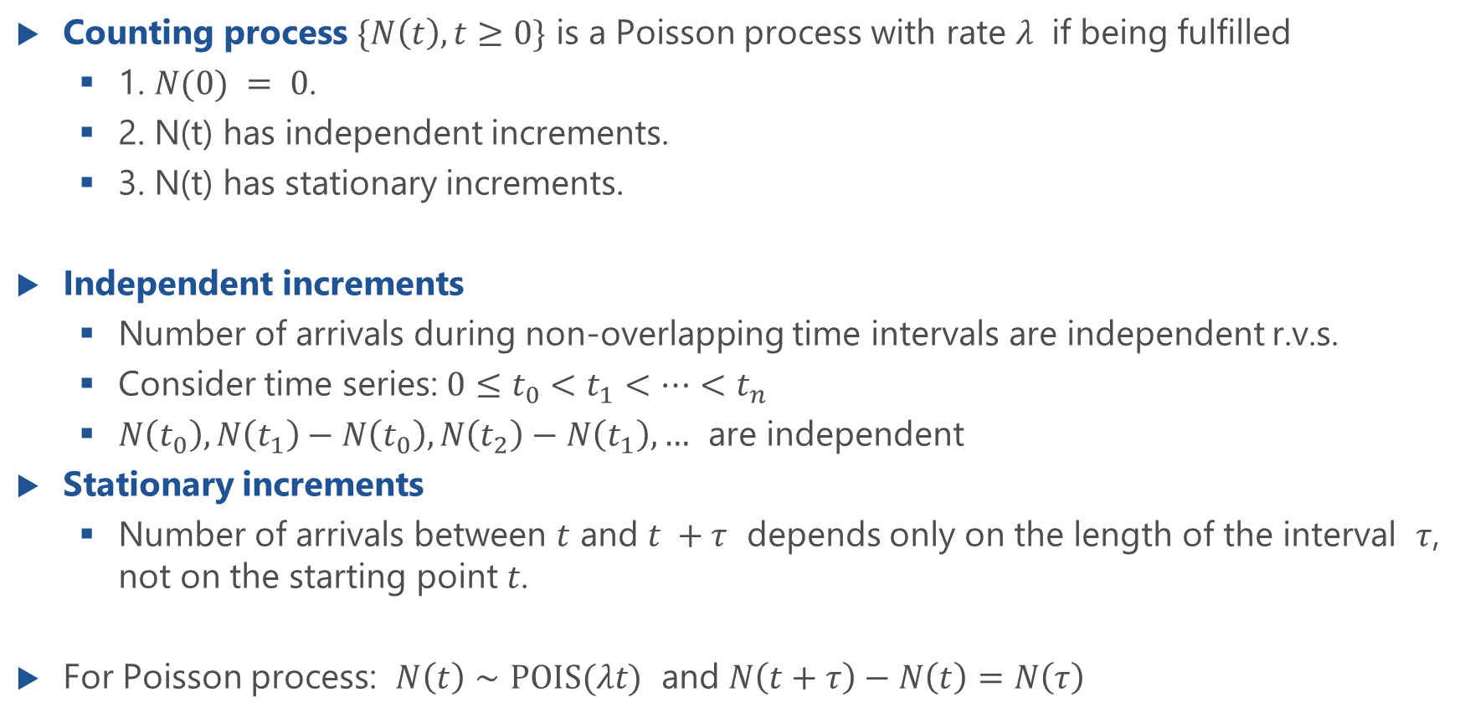
Poisson Process as Counting Process
Counting process $\{N\left(t\right),t≥0\}$ is a Poisson process with rate $λ$ if being fulfilled
1. $N(0) = 0$.
2. N(t) has independent increments.
3. N(t) has stationary increments.
Independent increments
Number of arrivals during non-overlapping time intervals are independent r.v.s.
Consider time series: $0≤t_{0}<t_{1}<…<t_{n}$
$N\left(t_{0}\right), N\left(t_{1}\right)−N\left(t_{0}\right), N\left(t_{2}\right)−N\left(t_{1}\right),…$ are independent
Stationary increments
Number of arrivals between $t$ and $t +τ$ depends only on the length of the interval $τ$, not on the starting point $t$.
For Poisson process: $N\left(t\right)∼POIS(λt)$ and $N\left(t+τ\right)−N\left(t\right)=N\left(τ\right)$

Slide 6
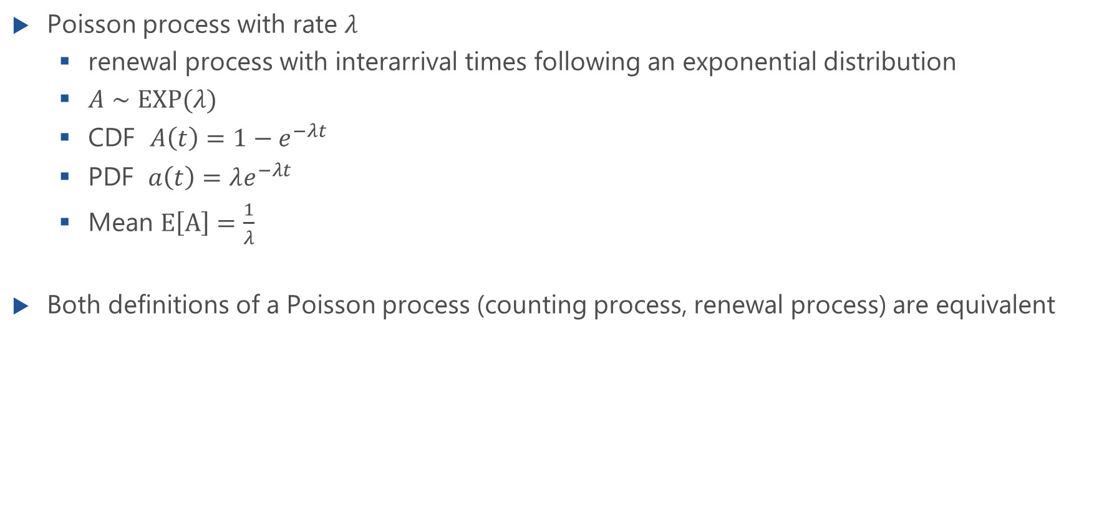
Poisson Process as Renewal Process
Poisson process with rate $λ$
renewal process with interarrival times following an exponential distribution
$A∼EXP(λ)$
CDF $A\left(t\right)=1−e^{−λt}$
PDF $a\left(t\right)=λe^{−λt}$
Mean $E\left[A\right]=\frac{1}{λ}$
Both definitions of a Poisson process (counting process, renewal process) are equivalent

Slide 7
Properties of a Poisson Process
Memoryless property, recurrence time, PASTA property

Slide 8
Poisson Process as Renewal Process
Poisson process with rate $λ$
renewal process with interarrival times following an exponential distribution
$A∼EXP(λ)$
CDF $A\left(t\right)=1−e^{−λt}$
PDF $a\left(t\right)=λe^{−λt}$
Mean $E\left[A\right]=\frac{1}{λ}$
Both definitions of a Poisson process (counting process, renewal process) are equivalent

Slide 9
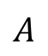
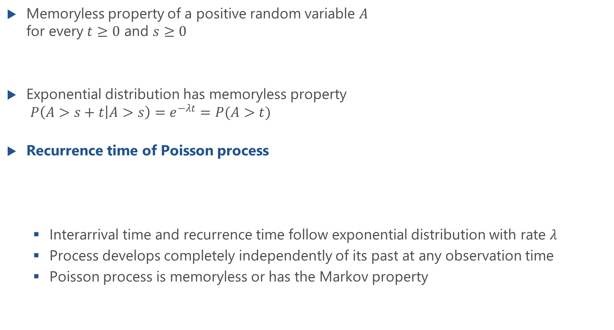

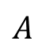
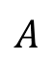

Memoryless Property for Poisson Process
Memoryless property of a positive random variable $A$ for every $t≥0$ and $s≥0$
Exponential distribution has memoryless property $P\left(A>s+t | A>s\right)=e^{−λt}=P(A>t)$
Recurrence time of Poisson process
Interarrival time and recurrence time follow exponential distribution with rate $λ$
Process develops completely independently of its past at any observation time
Poisson process is memoryless or has the Markov property
$$P\left(A>s+t | A>s\right)=P(A>t)$$
$$A$$
$$A$$
$$A$$
$$A$$

Slide 10

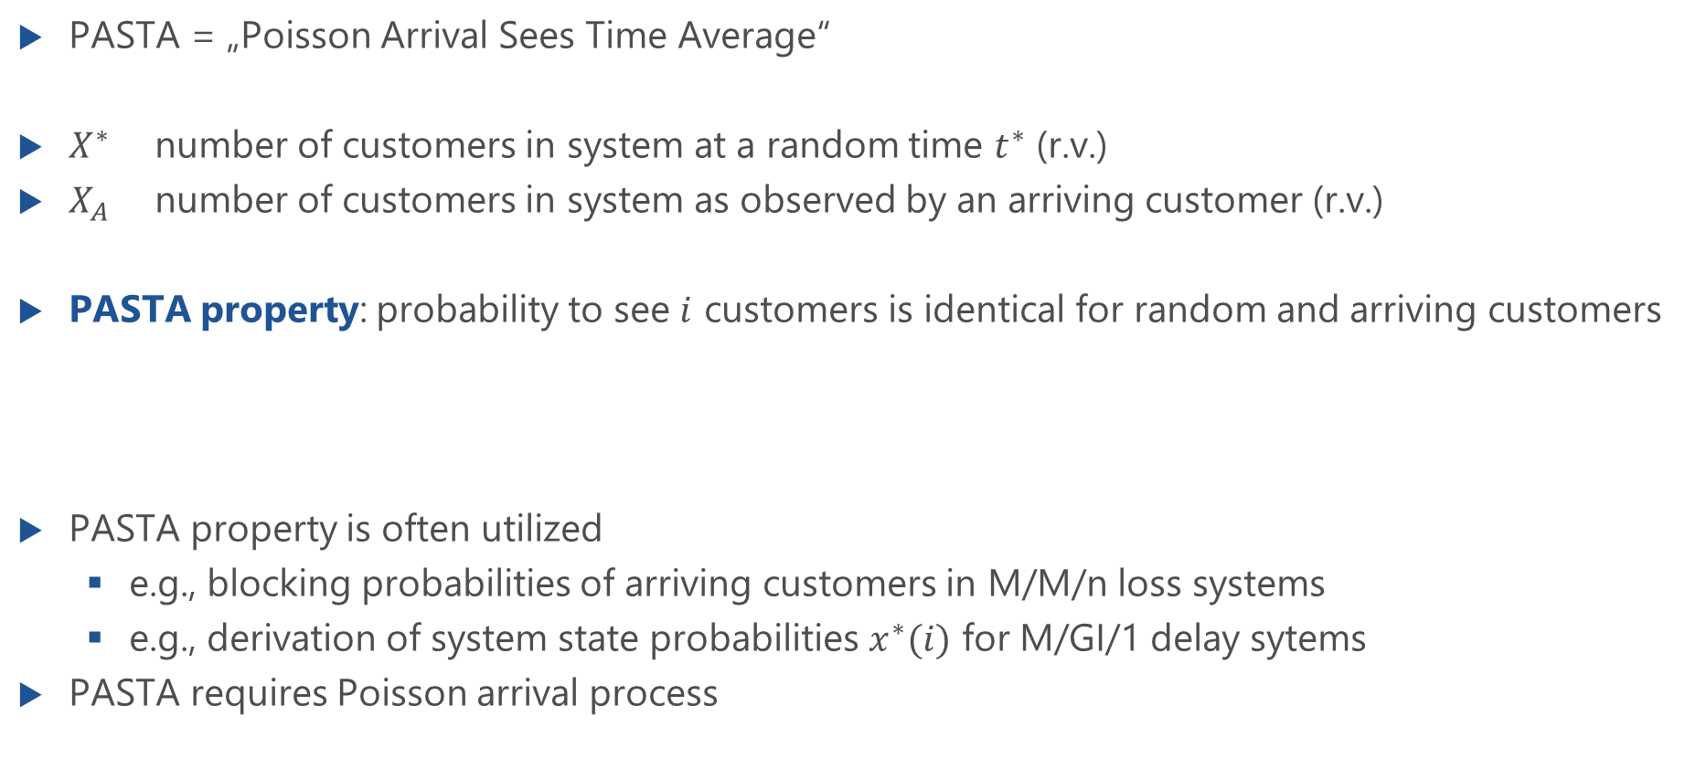
PASTA Property
PASTA = „Poisson Arrival Sees Time Average“
$X^{∗}$ number of customers in system at a random time $t^{∗}$ (r.v.)
$X_{A}$ number of customers in system as observed by an arriving customer (r.v.)
PASTA property: probability to see $i$ customers is identical for random and arriving customers
PASTA property is often utilized
e.g., blocking probabilities of arriving customers in M/M/n loss systems
e.g., derivation of system state probabilities $x^{∗}(i)$ for M/GI/1 delay sytems
PASTA requires Poisson arrival process
$x^{∗}\left(i\right)=x_{A}(i)$, $i=0,1,…$

Slide 11
PASTA Property
Lecture

Slide 12
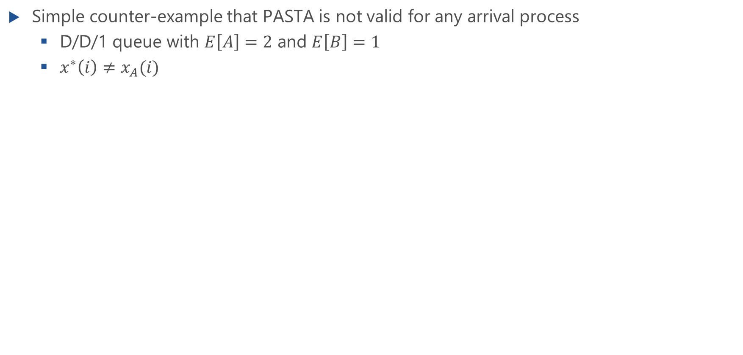
Counter-example: PASTA
Lecture
Simple counter-example that PASTA is not valid for any arrival process
D/D/1 queue with $E\left[A\right]=2$ and $E\left[B\right]=1$
$x^{∗}\left(i\right)≠x_{A}(i)$

Slide 13
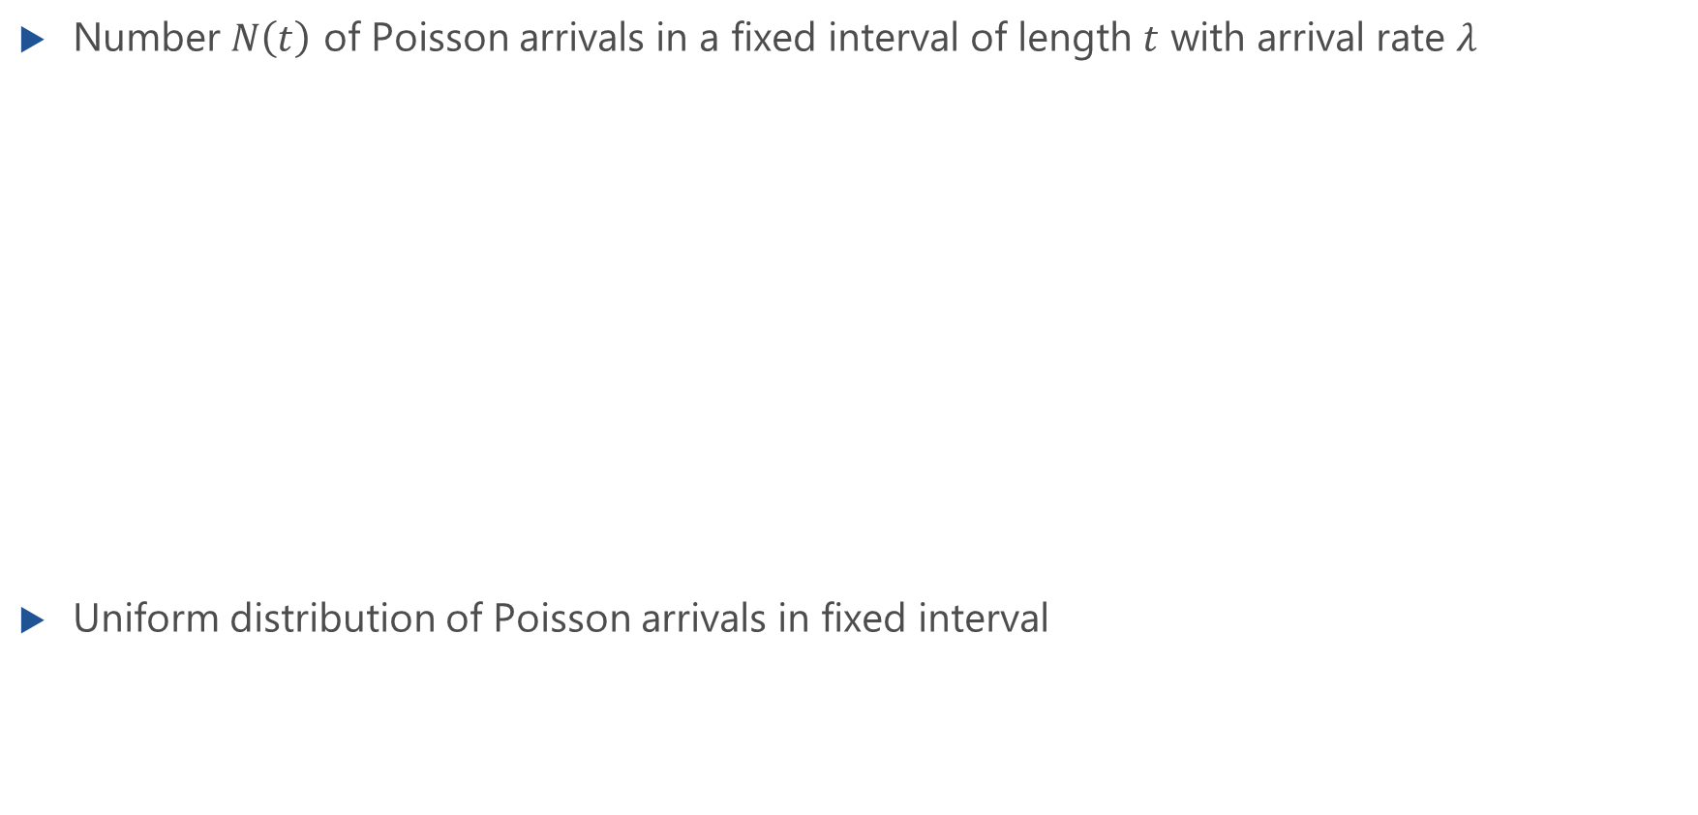
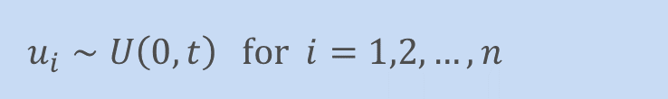
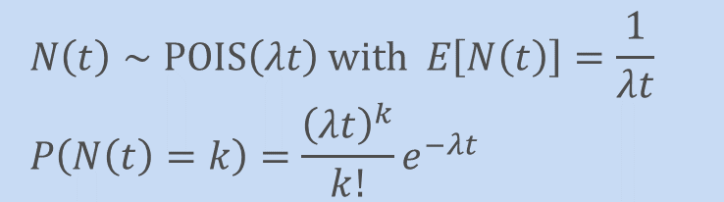
Arrivals in Fixed Interval
Number $N\left(t\right)$ of Poisson arrivals in a fixed interval of length $t$ with arrival rate $λ$
Uniform distribution of Poisson arrivals in fixed interval
$$N\left(t\right)∼POIS\left(λt\right) with E\left[N\left(t\right)\right]=\frac{1}{λt}$$
$$P\left(N\left(t\right)=k\right)=\frac{{\left(λt\right)}^{k}}{k!}e^{−λt}$$
$$u_{i}∼U\left(0,t\right) for i=1,2,…,n$$

Slide 14
Merging and Splitting of Poisson Processes

Slide 15
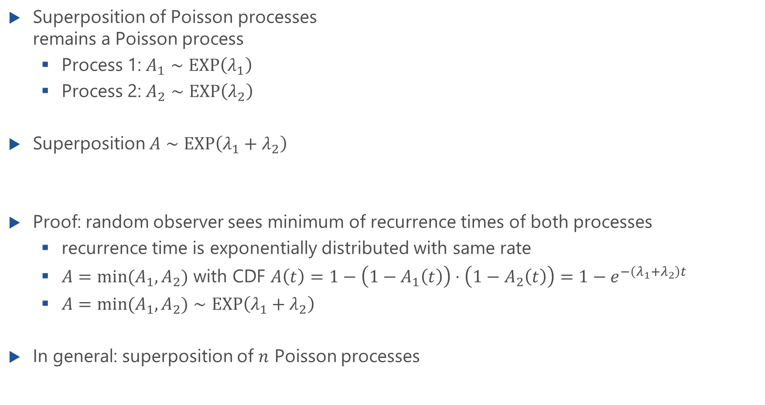
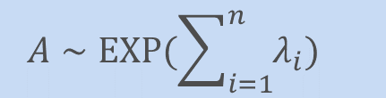
Merging of Poisson Processes
Superposition of Poisson processes remains a Poisson process
Process 1: $A_{1}∼EXP\left(λ_{1}\right)$
Process 2: $A_{2}∼EXP\left(λ_{2}\right)$
Superposition $A∼EXP\left({λ_{1}+λ}_{2}\right)$
Proof: random observer sees minimum of recurrence times of both processes
recurrence time is exponentially distributed with same rate
$A=min⁡(A_{1},A_{2})$ with CDF $A\left(t\right)=1−\left(1−A_{1}\left(t\right)\right)⋅\left(1−A_{2}\left(t\right)\right)=1−e^{−\left(λ_{1}+λ_{2}\right)t}$
$A=min⁡(A_{1},A_{2})∼EXP\left({λ_{1}+λ}_{2}\right)$
In general: superposition of $n$ Poisson processes
$$A∼EXP(\sum_{i=1}^{n}{λ_{i}})$$

Slide 16
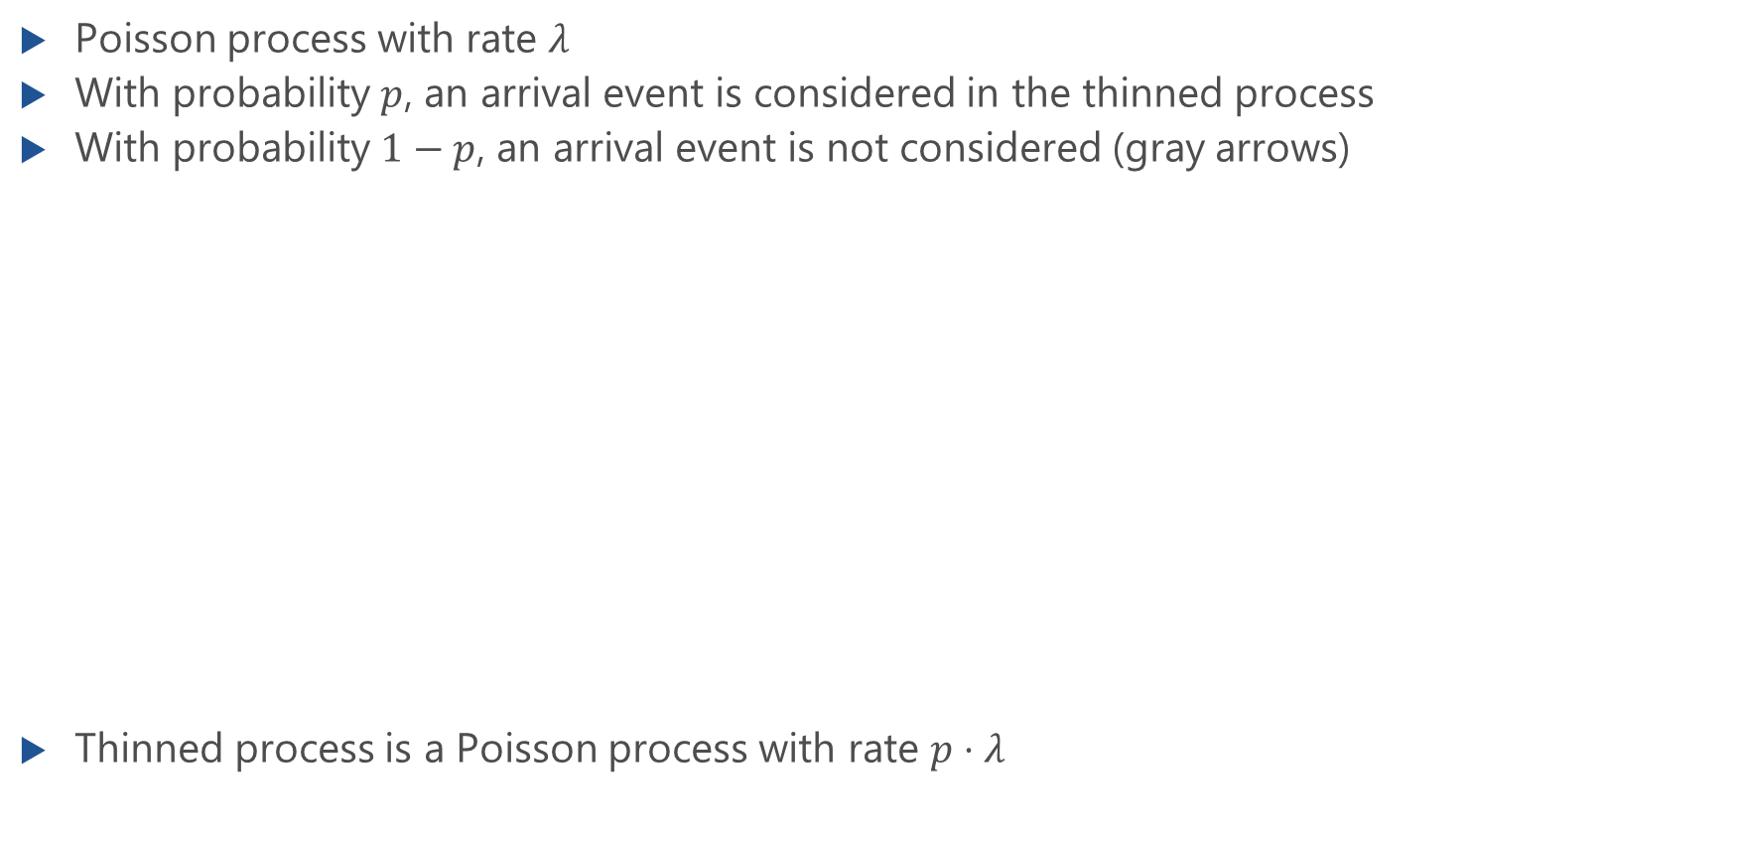
Random Thinning of Poisson Processes
Poisson process with rate $λ$
With probability $p$, an arrival event is considered in the thinned process
With probability $1−p$, an arrival event is not considered (gray arrows)
Thinned process is a Poisson process with rate $p⋅λ$

Slide 17
Random Thinning of Poisson Processes
Lecture

Slide 18
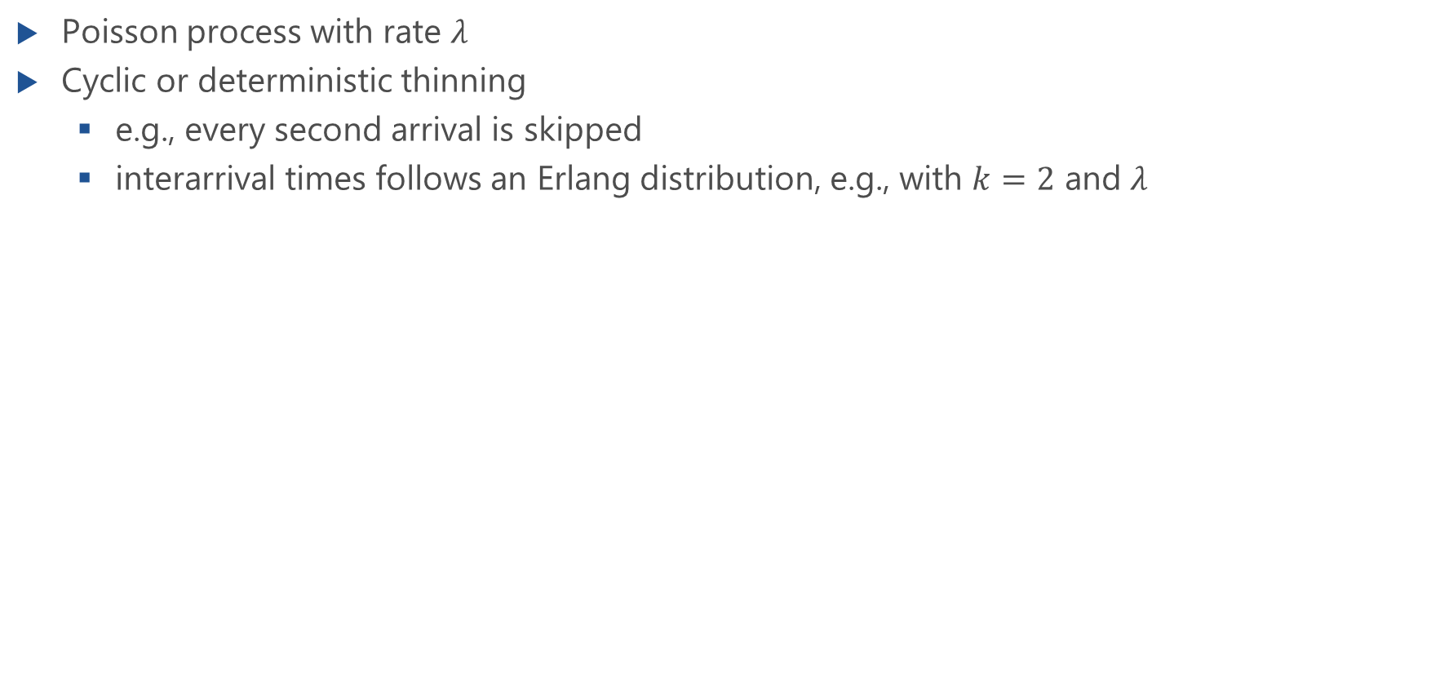
Cyclic Thinning of Poisson Processes
Poisson process with rate $λ$
Cyclic or deterministic thinning
e.g., every second arrival is skipped
interarrival times follows an Erlang distribution, e.g., with $k=2$ and $λ$

Slide 19
Poisson Arrivals during an Arbitrarily Distributed Interval

Slide 20
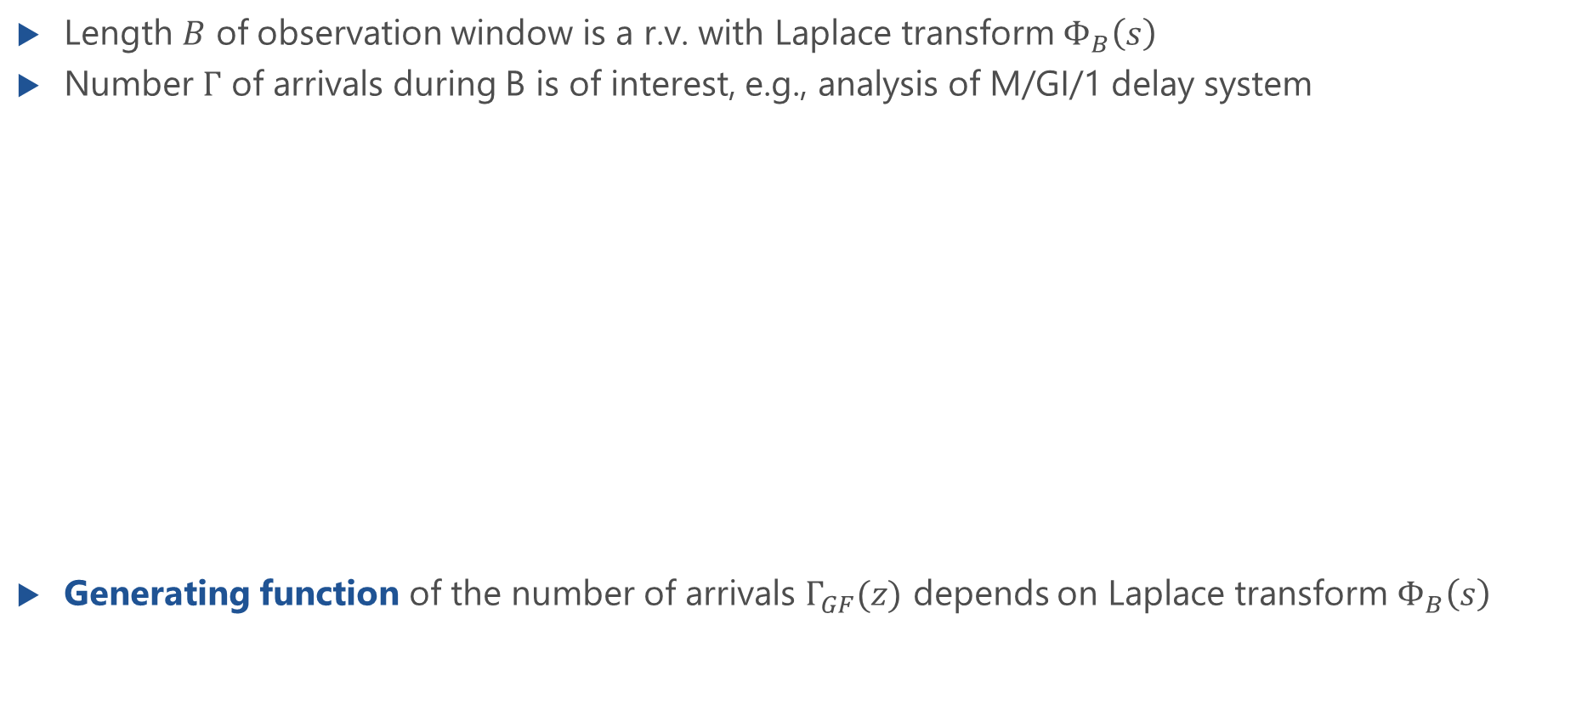
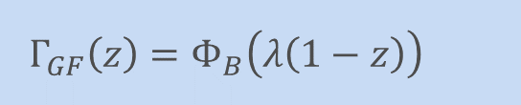
Arbitrarily Distributed Observation Interval
Length $B$ of observation window is a r.v. with Laplace transform $Φ_{B}\left(s\right)$
Number $Γ$ of arrivals during B is of interest, e.g., analysis of M/GI/1 delay system
Generating function of the number of arrivals $Γ_{GF}(z)$ depends on Laplace transform $Φ_{B}\left(s\right)$
$$Γ_{GF}\left(z\right)=Φ_{B}\left(λ\left(1−z\right)\right)$$

Slide 21
Proof
Lecture

